Slide 1


U.S. Border crossing arima model
By Paul Nguyen

Slide 2
Why Should We Care?
Both legal and illegal immigration have huge economic impacts
Narcotic flows coincide with border crossing flows
Accurate prediction helps appropriate funding and make proper recommendations for legislative reform to modernize the u.s. immigration system

Slide 3

Dataset description
Dataset compiled from 1996 to 2020
It contains all the inbound crossings at the U.S. border provided by the U.S. Bureau of Transportation Statistics
7 columns (Port Name, State, Port Code, Border MEX/CAN, Date, Measure, and Value)
Contains 355,512 entries
This Photo by Unknown Author is licensed under CC BY-NC

Slide 4
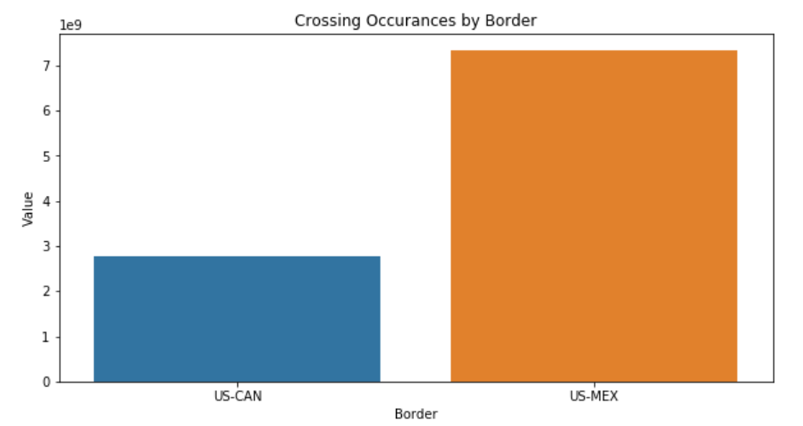
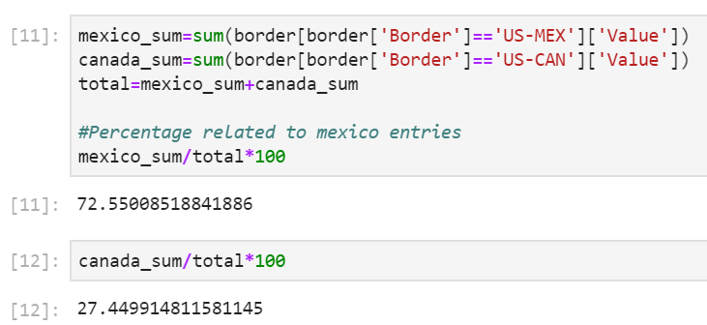
Descriptive Analysis

Slide 5
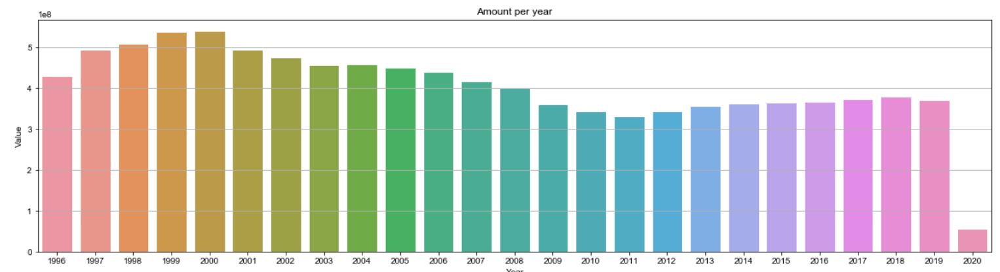
Descriptive Analysis Cont.
Total number of crossings categorized by year (1996-2020)

Slide 6
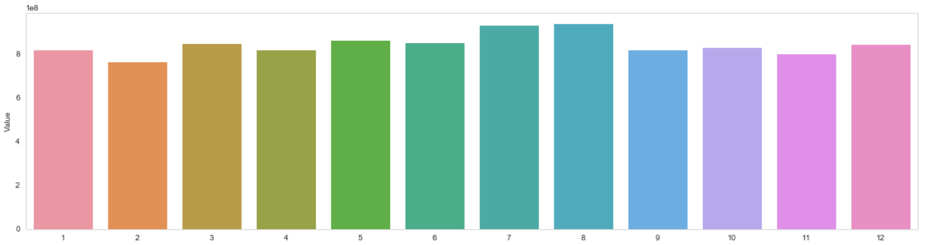
Total of crossings categorized by month
This reveals July and August are the busiest months at the borders

Slide 7
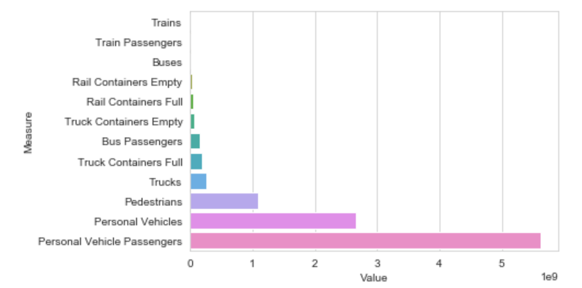
Crossings categorized by method
Personal vehicles and passengers are by far the most popular form to cross the borders.

Slide 8
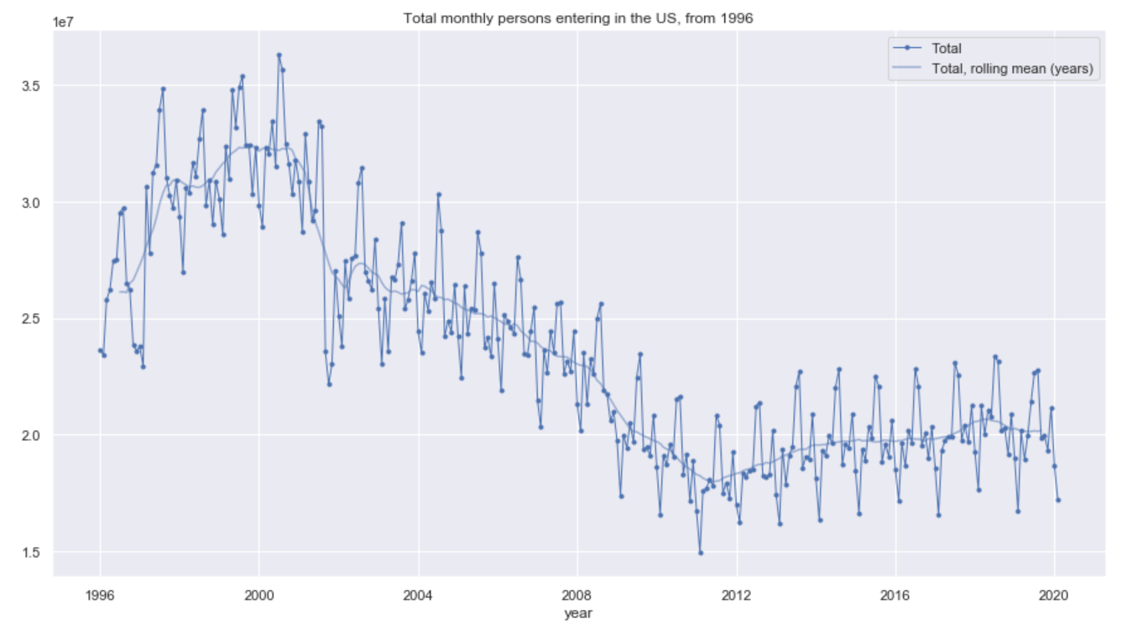
ARIMA Model
Establishing the running average for the dataset

Slide 9
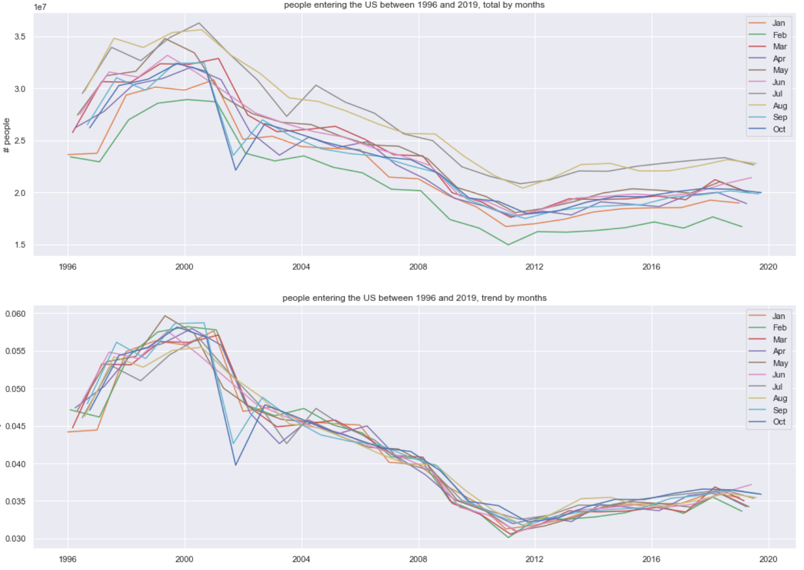
Border crossings by month 1996-2019
We can see that both the total number of crossings grouped by month and their trends are declining for our time period.

Slide 10
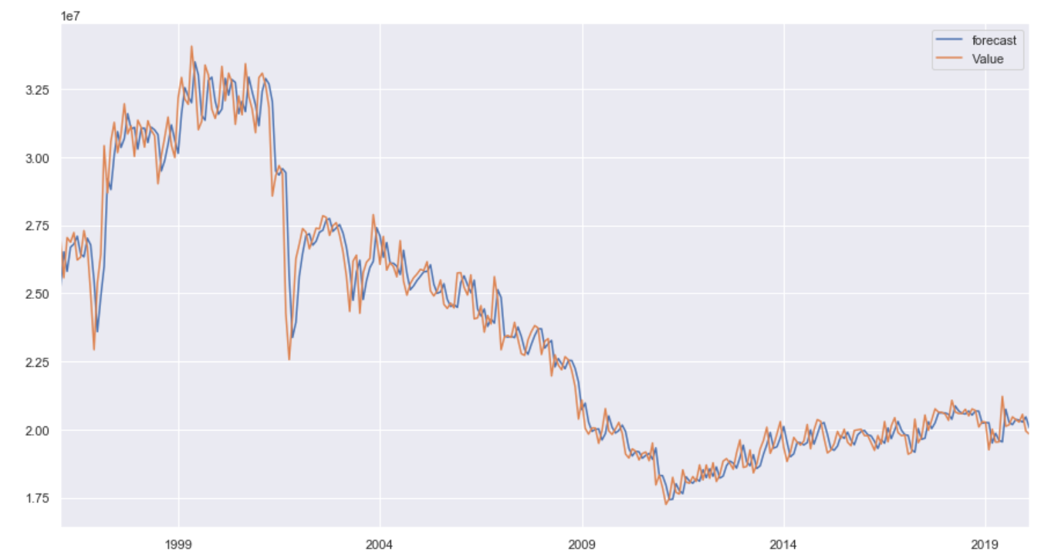
ARIMA model #1 (1996-2019)
Second differencing used for series to be stationary
Timeframe used to train model was 1996-2019
P-Value= 0.000009
Result is overfitting in linear model

Slide 11
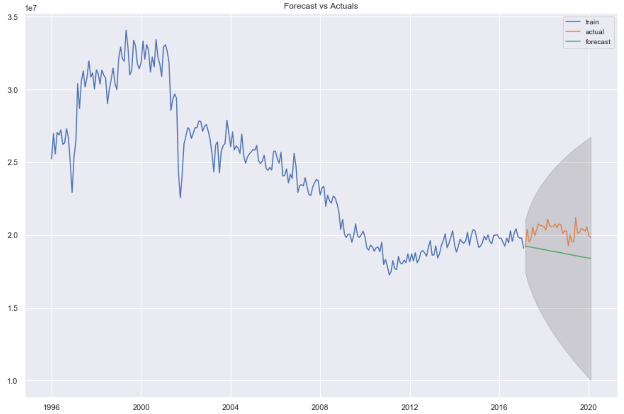
Prediction of ARIMA Model #1
Since trend is declining from 1996 to 2019, the model is predicting the continuation of the downward trend for 2020.
However, because of the overfitting of the linear model, the probability of error is high.
This model is not to be trusted
We will shorten the training timeframe to reduce noise and achieve more accuracy

Slide 12
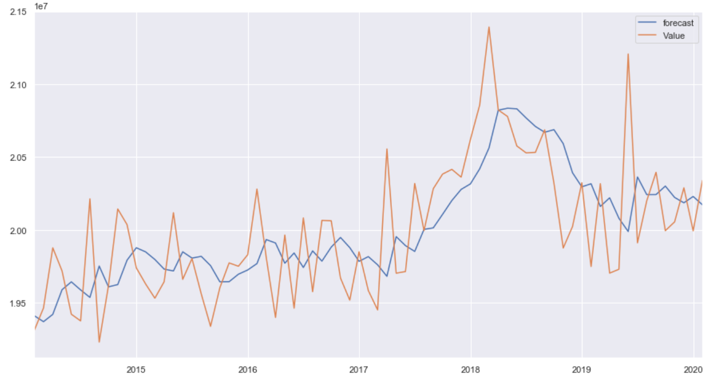
ARIMA model #2 (2014-2019)
Second differencing used for series to be stationary
P-Value= 0.000000
Timeframe used to train model was 2014-2019
Forecast is trending along with actual values, but not overfitting

Slide 13
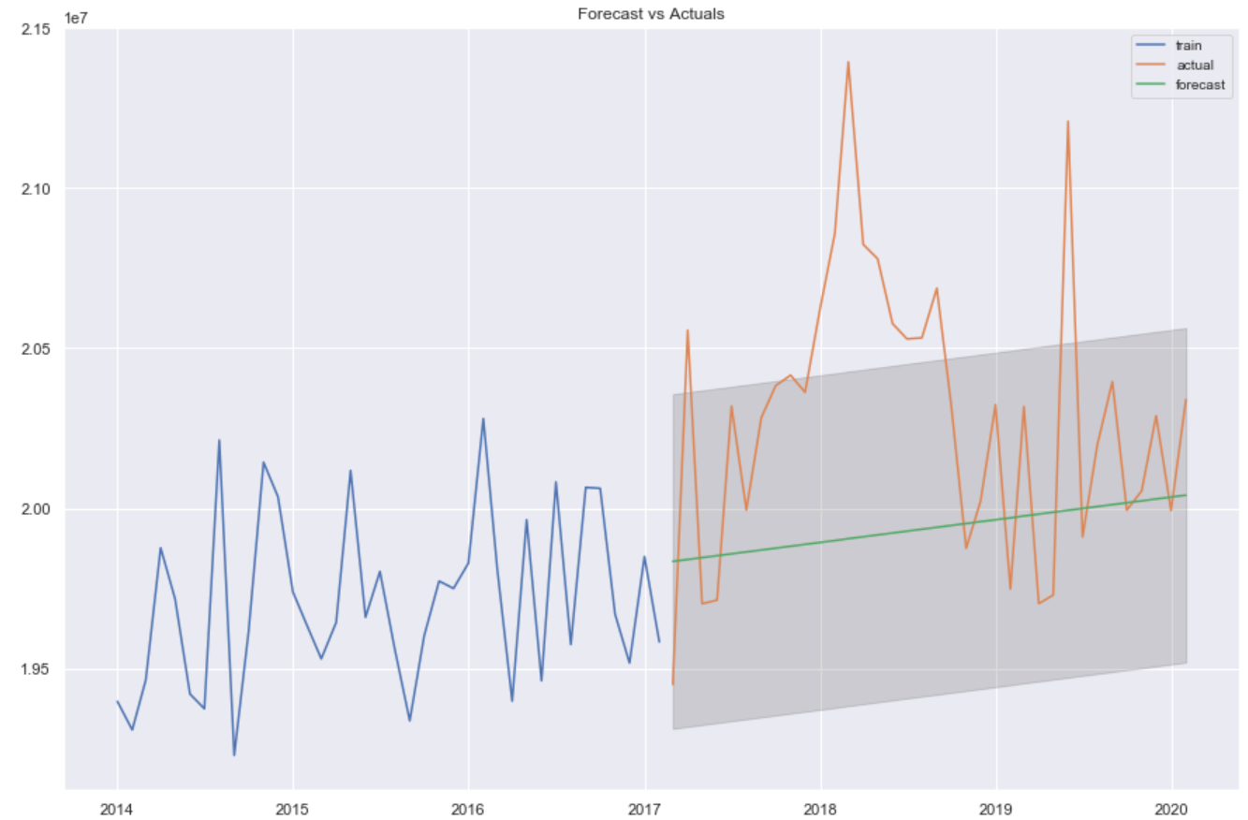
Prediction of ARIMA Model #2
The trend is upward for this five-year period
There is no overfitting of the linear model
Prediction is also trending upward in accordance to the last five years
Margin of error is much smaller for this model due to less noise. Therefore, it is more accurate

Slide 14
Conclusion
Taking seasonal effect into consideration, using the last 5 years to predict 2020 is much more accurate due to less noise
Too large of test set can result in overfitting of linear model
~73% of border crossings are at the Mexican border vs ~27% at the Canadian border
July and August are the busiest months at the border
Most crossings are in personal vehicles
Recommendations:
With border crossings predicted to increase in 2020 due to political and economical reasons, proportionate funding should be reserved for southern border states.
Humanitarian efforts should be concentrated in July and August due to increase in traffic
Realtime Object Detection and Facial Recognition technologies should be deployed to scan personal vehicles and faces against criminal database

Slide 15
References
(n.d.). Kaggle.com. Retrieved on 05/04/2020. https://www.kaggle.com/divyansh22/us-border-crossing-data
Nicholson, M., D. (04/20/2017). The Facts on Immigration Today: 2017 Edition. Center of American Progress. Retrieved on 05/10/2020. https://www.americanprogress.org/issues/immigration/reports/2017/04/20/430736/facts-immigration-today-2017-edition/
Prabhakaran, S. (n.d.). ARIMA Model – Complete Guide to Time Series Forecasting in Python. Machine Learning Plus. Retrieved on 05/08/2020 https://www.machinelearningplus.com/time-series/arima-model-time-series-forecasting-python/
Maklin, C. (05/25/2019). ARIMA Model Python Example — Time Series Forecasting. Towards Data Science. Retrieved on 05/09/2020 https://towardsdatascience.com/machine-learning-part-19-time-series-and-autoregressive-integrated-moving-average-model-arima-c1005347b0d7

